Slide 1

Introduction to Apache Spark

Slide 2

What is Apache Spark?
Open Source
Processing Data in Parallel
Adaptability (SQL, Streaming, machine learning, graph processing)
In memory processing
Built-in data processing tasks

Slide 3






Applications of Apache Spark
E-Commerce
Healthcare
Finance
Telecommunication
Manufacturing
Advertising

Slide 4
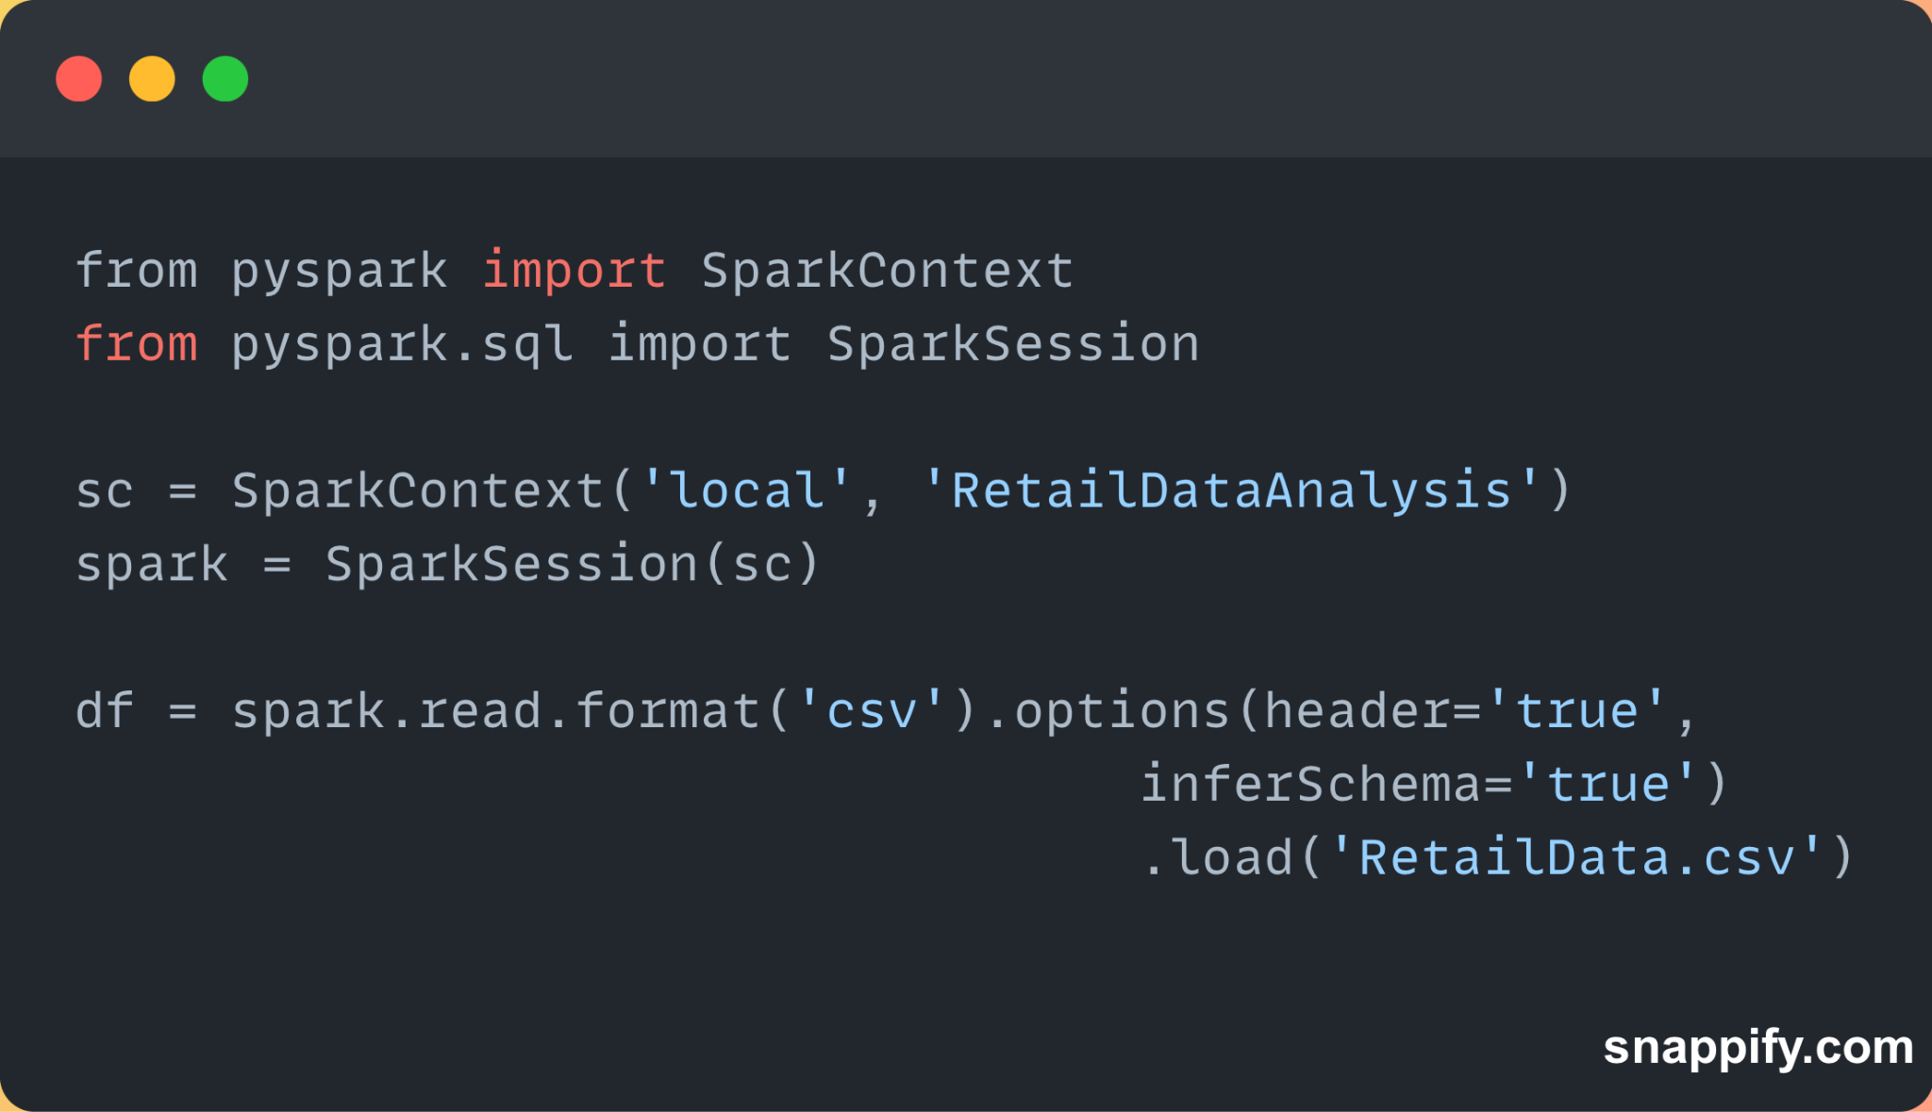
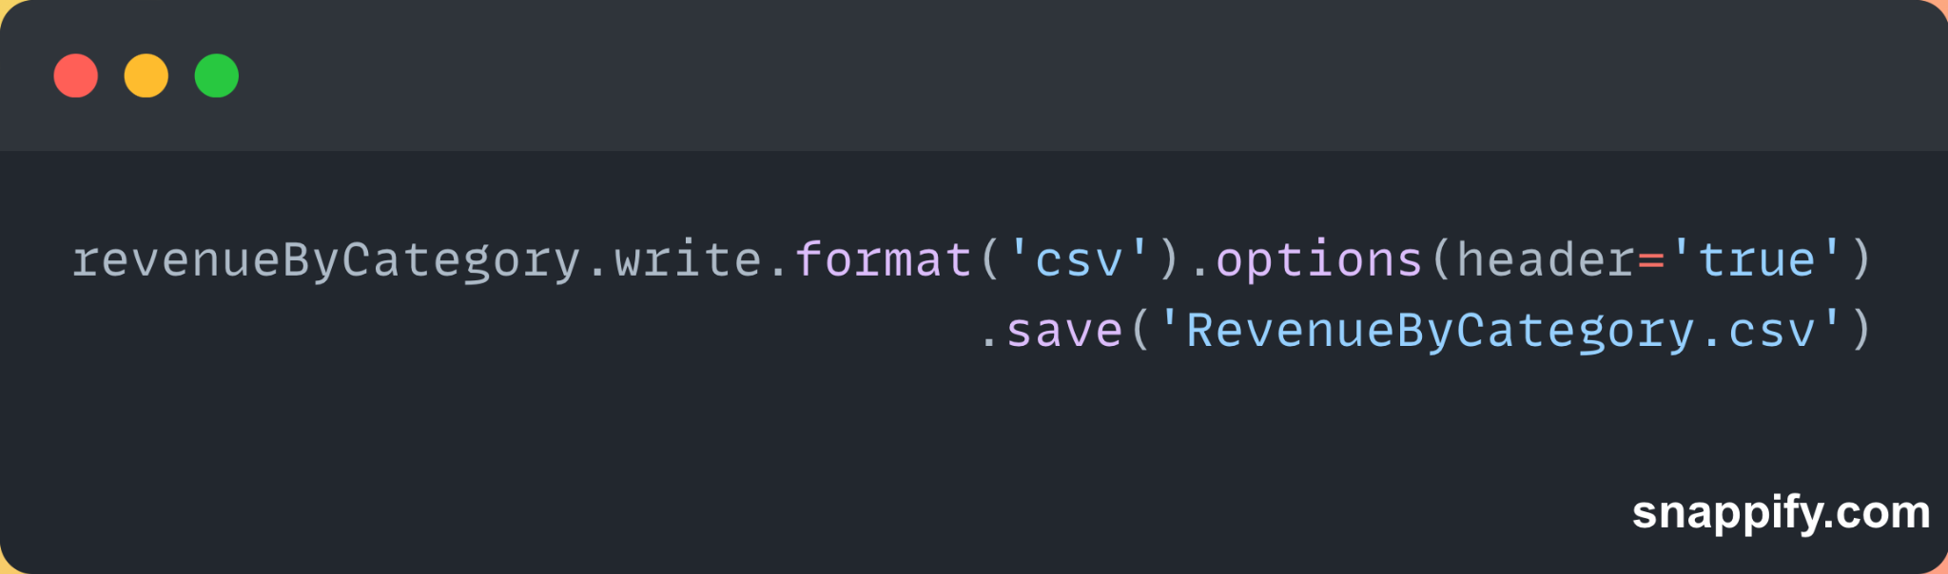
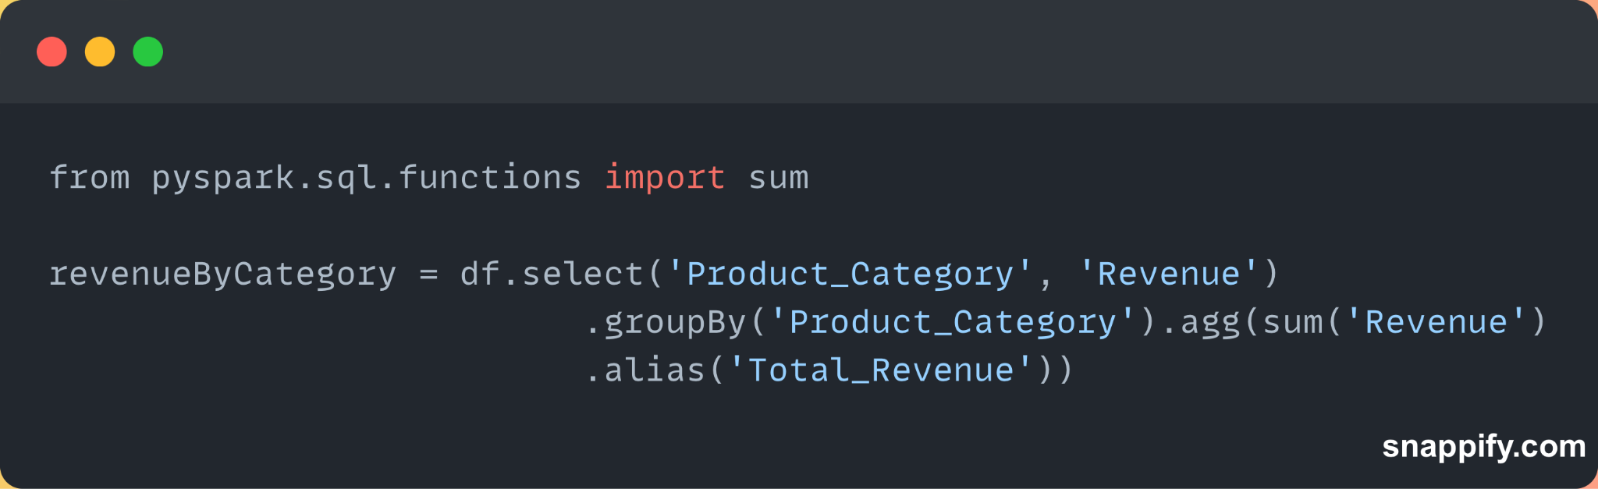
Example of Apache Spark
3. Save the results for further analysis
Load data set
2. Filter data

Slide 5
Next…

